Slide 1
Macroeconomic Outlook 2017
As of September 2017

Slide 2
Major Events 2017
Tell us what you think

Slide 3
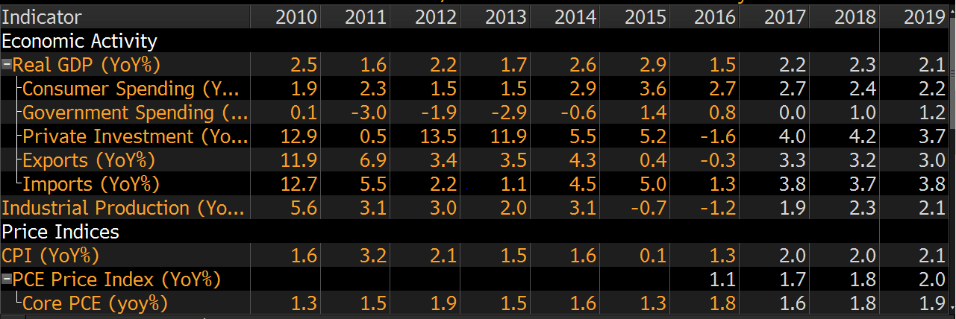
Domestic Economic Outlook

Slide 4
Housing Starts

Slide 5
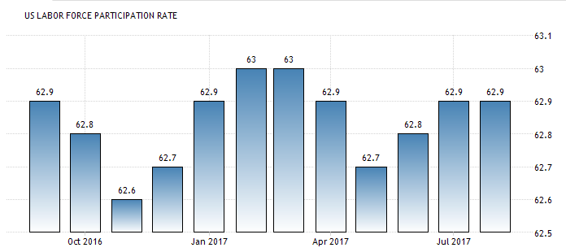
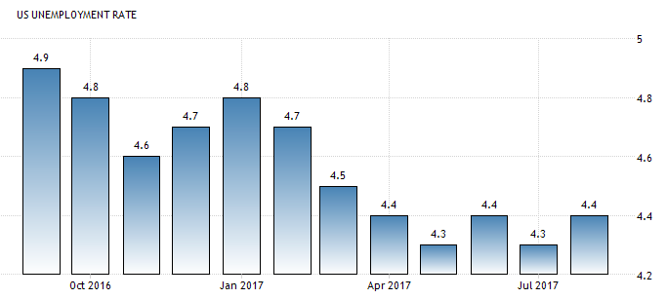
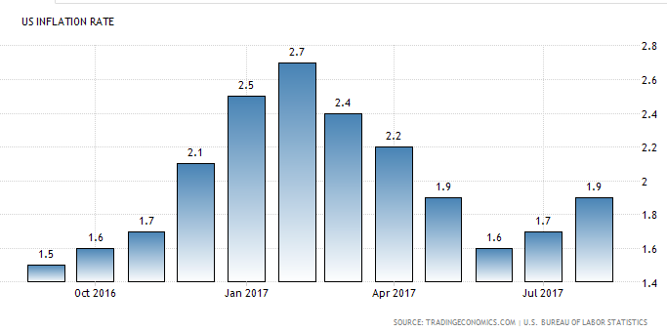
Domestic Economic Outlook

Slide 6
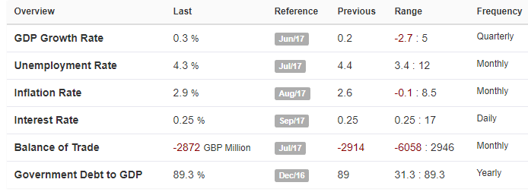
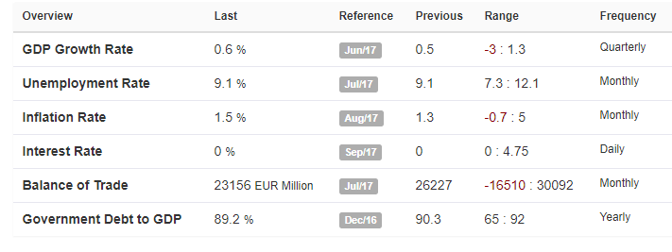
Global Economic Outlook
U.K
Euro-Zone
Moody’s downgrades from Aa1 to Aa2
Weakened prospect for public finances
Brexit-linked economic slowdown ahead
Pound’s sharp depreciation after the Brexit vote last year has accelerated inflation
Germany: Merkel Wins but Loses Ground
Weaker than expected victory
Anti-Immigration (AFD) party won 12% of the vote
Euro slides, Dollar rises after election results

Slide 7
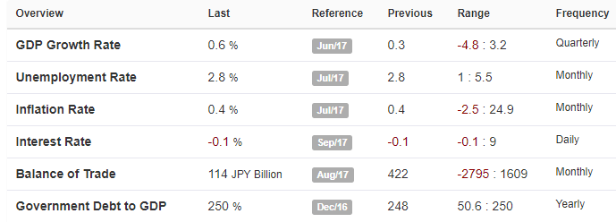
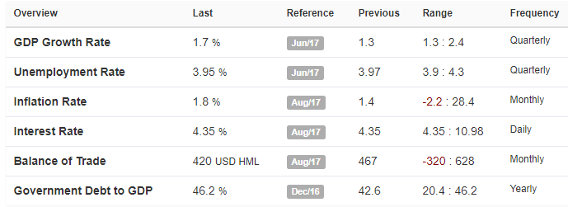
Global Economic Outlook
Japan China
Prime Minister (Shinzo Abe) Snap Election Oct. 22
Economic growth in 2nd Quarter surprisingly strong
Popularity plunged to around 30% after scandals
Ordered a New ¥2 Trillion Economic Package by the End of the Year
S&P cut its rating from AA- to A+
Citing increased financial risks
No Chinese Stocks (No transparency)
Issue: Government interference in businesses
Catalyst: Diversifying into Chinese markets

Slide 8
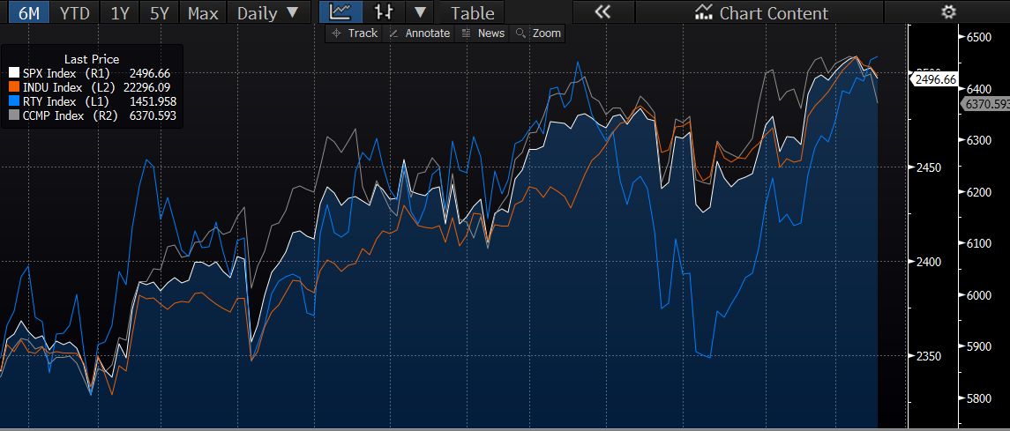
U.S. Equity Market
6-month returns
DJIA (INDU): 8.75%
S&P 500 (SPX): 6.86%
NASDAQ (CCMP): 10.74%
Russell 2000 (RTY): 6.89%

Slide 9
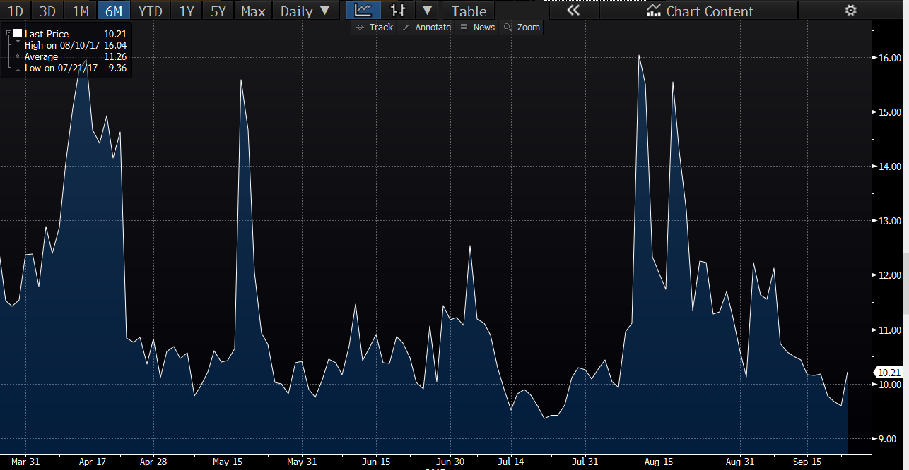
Volatility Index (VIX)

Slide 10
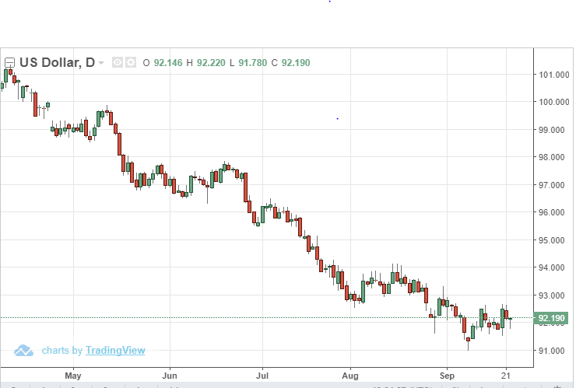
US Dollar Index

Slide 11
Trump: The man of 140 characters
Notes:
North Korea - North korean conflict recently escalated when the North Korean government said that they would shoot down any aircraft from the US and that they believed we had declared war. The US then flew an aircraft over the North/South border.
Tariff - Trump has threatened as much as a 45% tariff, these tariffs do not look they will apply to everyone as some companies are being told they will be exempt

Slide 12
Trump: The saga continues
Notes:
Trump wants to ban trade from countries who openly fund terrorism. Recently… “... when a government board cleared the way for him to deploy a long-dormant legal weapon to restrict solar panel imports.” (WSJ)

Slide 13
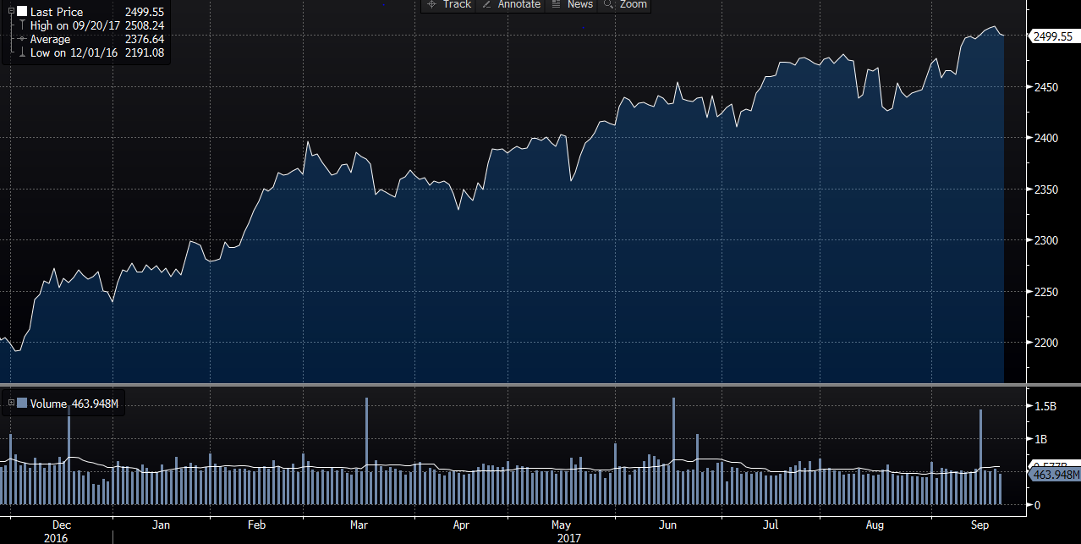
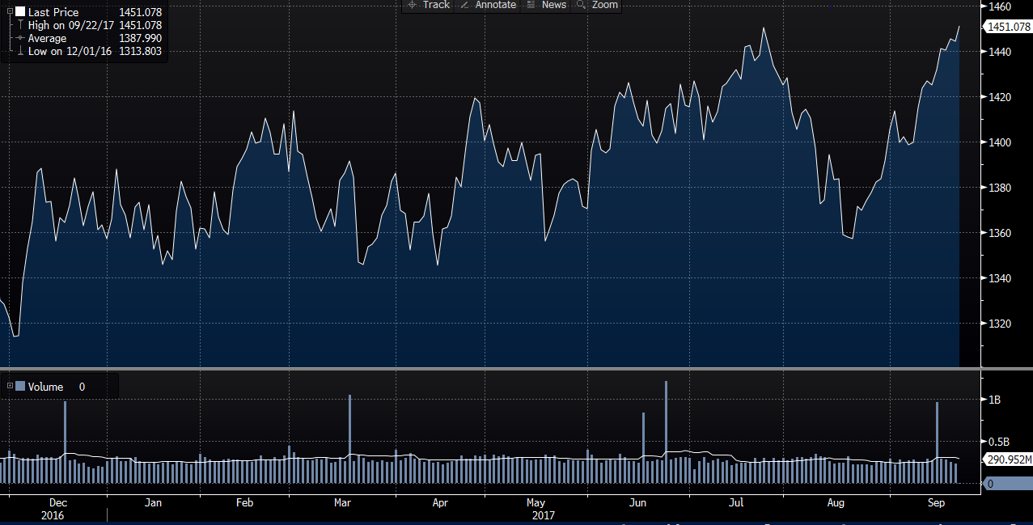
Market Reaction Since Election
S&P 500
Russell 2000

Slide 14
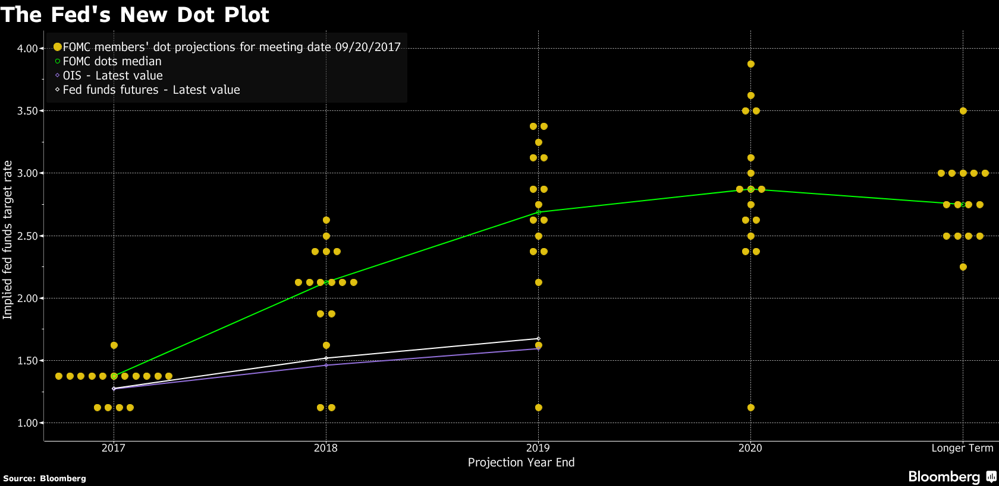
Federal Reserve

Slide 15
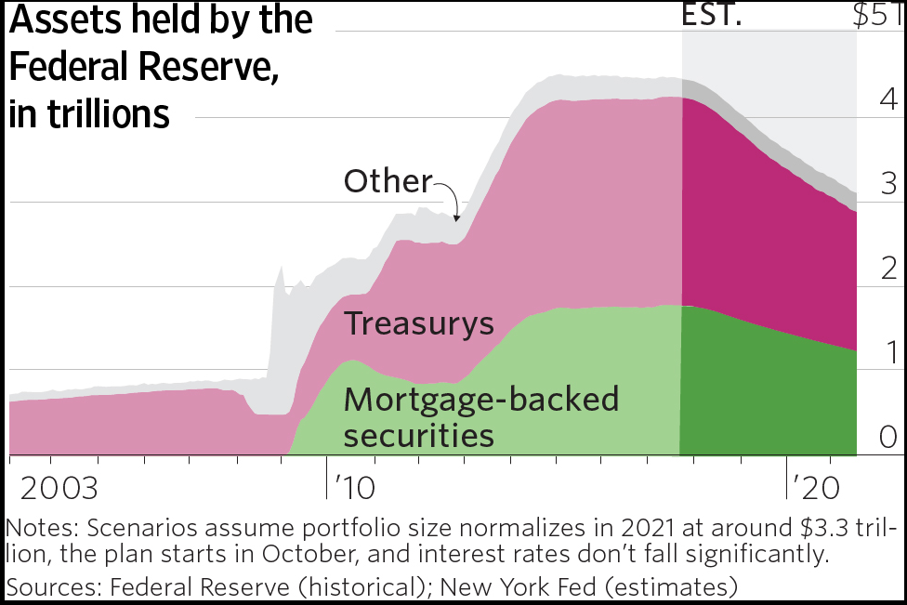
Fed Balance Sheet Unwinding
Fed Announced that it would be unwinding the balance sheet by around $10 Billion each month
This will push up long term interest rates, helping bank profitability
Banks will have to relocate excess reserves to new assets, potentially earning more than they had with Fed deposits

Slide 16
Healthcare Reform
Political action surrounding the ACA will provide volatility in the upcoming months due to the uncertainty around the reforms that will be made
The movement to repeal and replace failed, but both parties will be working on proposing a new solution.
As reform plans develop, there will be opportunities to take advantage of the unusual volatility in this sector
Republicans announced they are likely unable to put a plan together by the end of the week, which means they are subject to a democratic filibuster if they present a plan in the future
Read the news

Slide 17
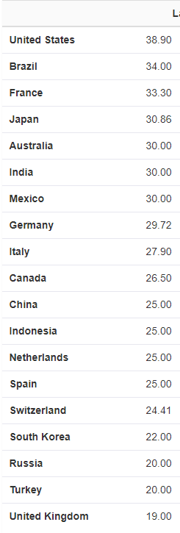
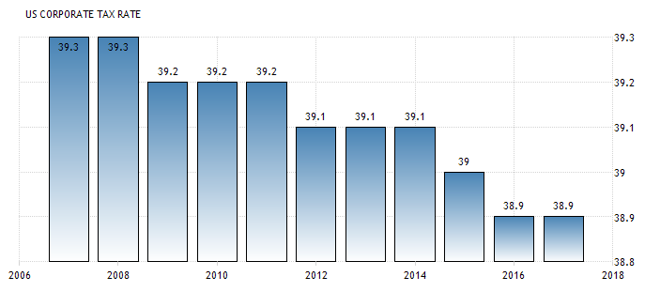
Tax Reform
Republicans plan to release tax reform framework this week
Negotiators pursuing a corporate rate of 20%
Trump suggested he would prefer to see a 15% rate
A tax code rewrite has not happened since 1986
Aiming to get tax reform done by the end of the year

Slide 18
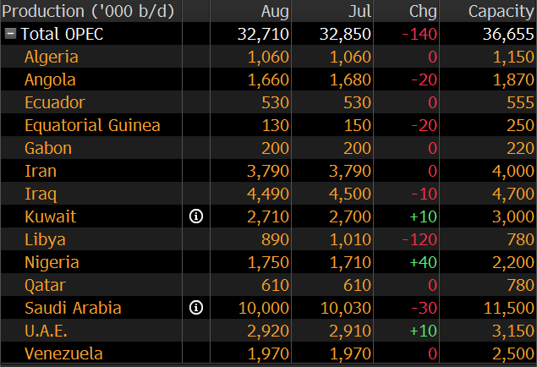
OPEC
Oil production cuts from OPEC have led to increased forecasts of demand
They have achieved 116% compliance with their proposed cuts however higher than expected production of Nigeria and Libya have decreased the benefits seen from these cuts
OPEC cuts have increased oil prices but it is uncertain how long they can continue or if they can expand them without non-OPEC productions filling the demand
It is projected that non-OPEC producers will increase output at a higher rate than these forecasted demand increases
Read the news

Slide 19
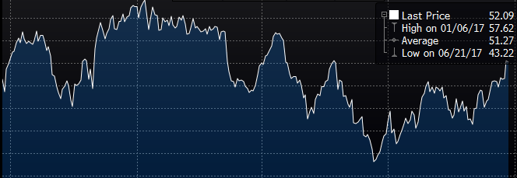
Crude Oil Prices
Down YTD, but up from a 12 month low of $43.22 on June 21
Look for the effects of this in Energy, Industrials, Travel, Consumer Goods, Materials, Food Industry
Ex: pushing up COGS for companies that make plastic goods

Slide 21
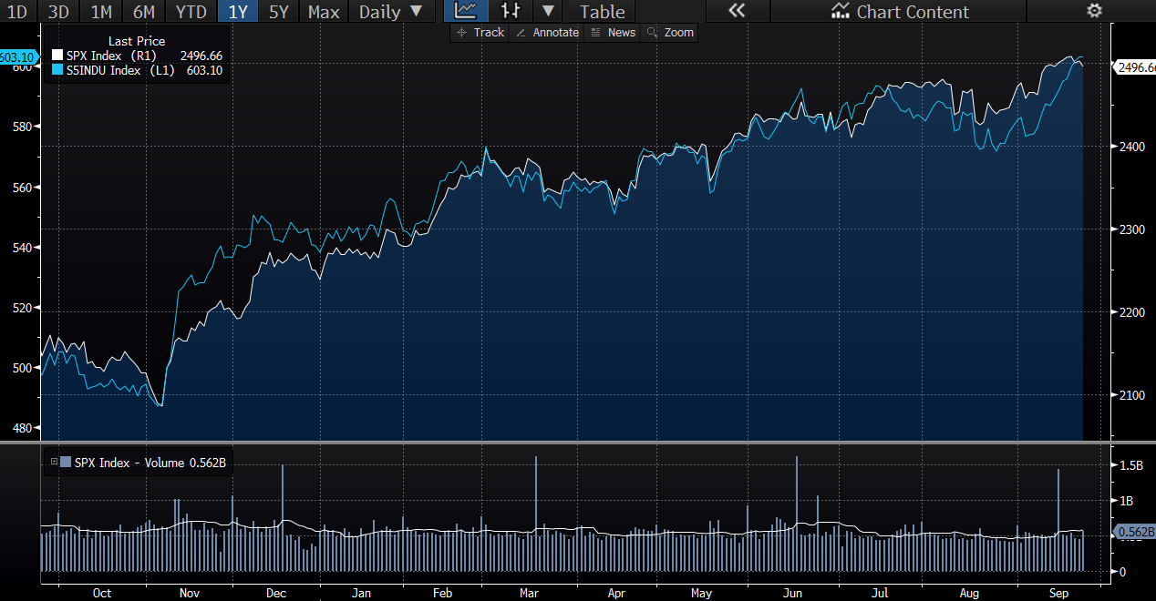
Defense Sector
Outlook - Strong
Reasoning - Conflict between Trump and other countries creates worry within markets
Raising oil prices may create tensions between providers and consumers (especially while America must rebuild oil infrastructure destroyed by hurricanes)
R&D put into market is beginning to pay out (Boeing), possibly creating trend of value generation
Notes:
Use Raytheon as an example of price being built in early on (not a ton of daily volatility so is reaction to news that strong?)

Slide 22
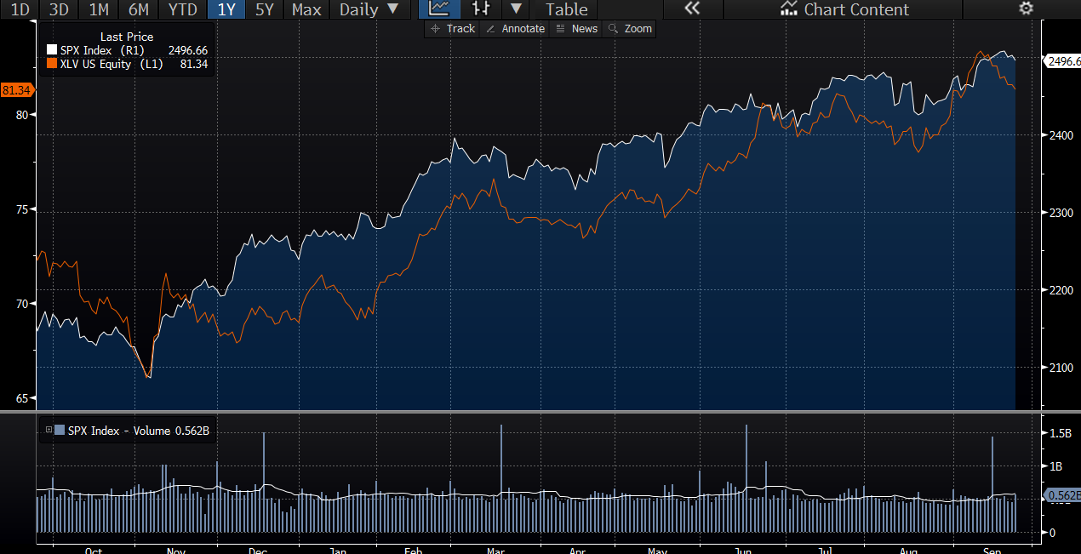
Healthcare Sector
Outlook - Strong
Reasons: Companies reporting healthy balance sheets, the sector was beaten down prior to election making current valuations attractive, demand for services grows with aging population
Areas of Concern: Higher than usual volatility due to uncertainty surrounding healthcare reform

Slide 23
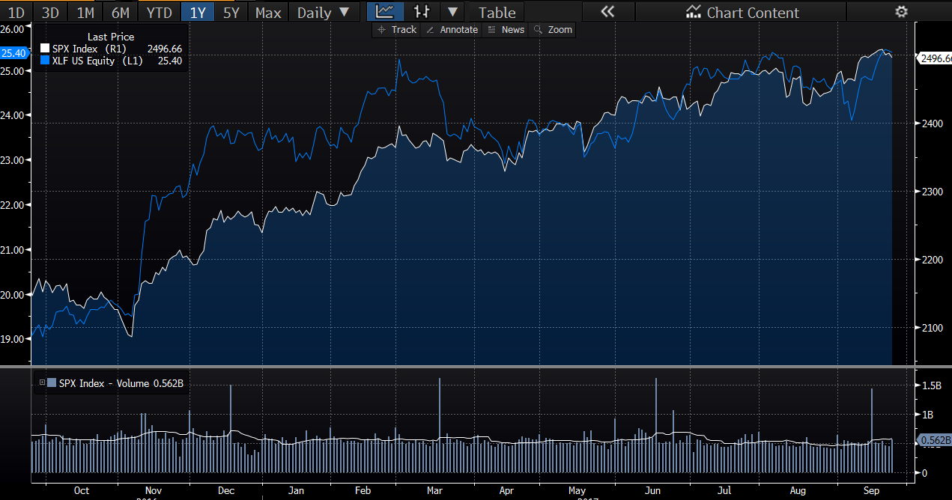
Financial Sector
Outlook - Strong
Reasons for outlook - Fed Funds rate hike, Lending institutions boosts
Possible area of caution - Balance sheet unwinding lowers bond price which oftentimes are used to create value for financial institution
Notes:
The federal funds rate will increase the value of the cash holdings of a bank (money goes into money market funds)
Able to charge clients more as the base rate will be higher (Short term is changed much more than long term)
10 Billion must be put into new assets which should raise the price

Slide 24
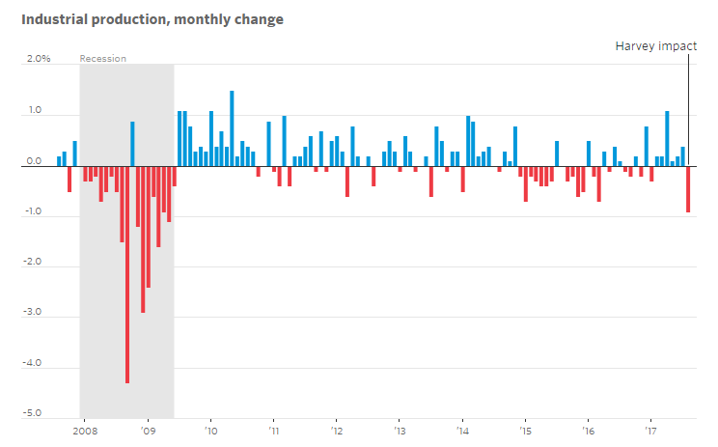
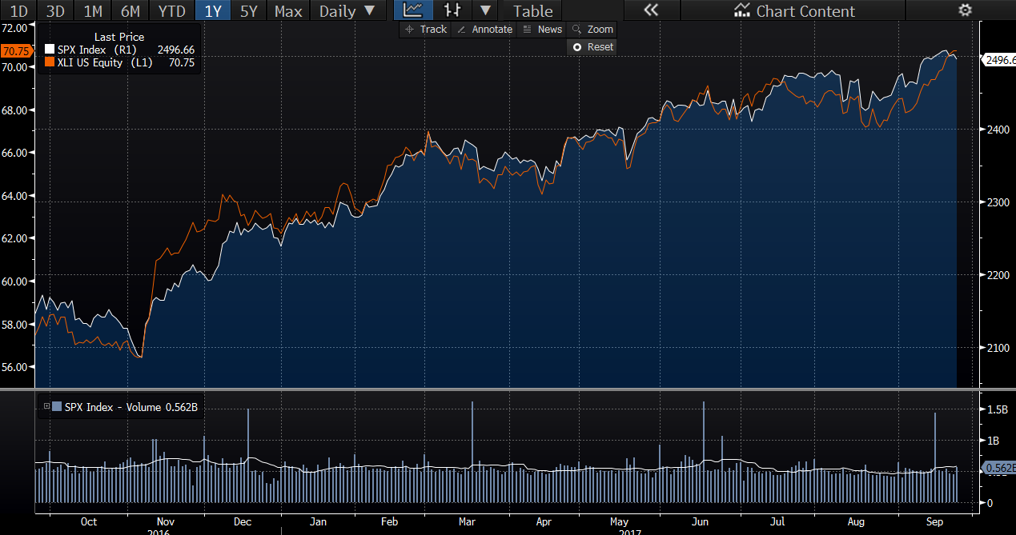
Industrial Sector
Outlook - Strong
Reasons for Outlook:
Infrastructure executive order boosts spending $1T

Slide 25
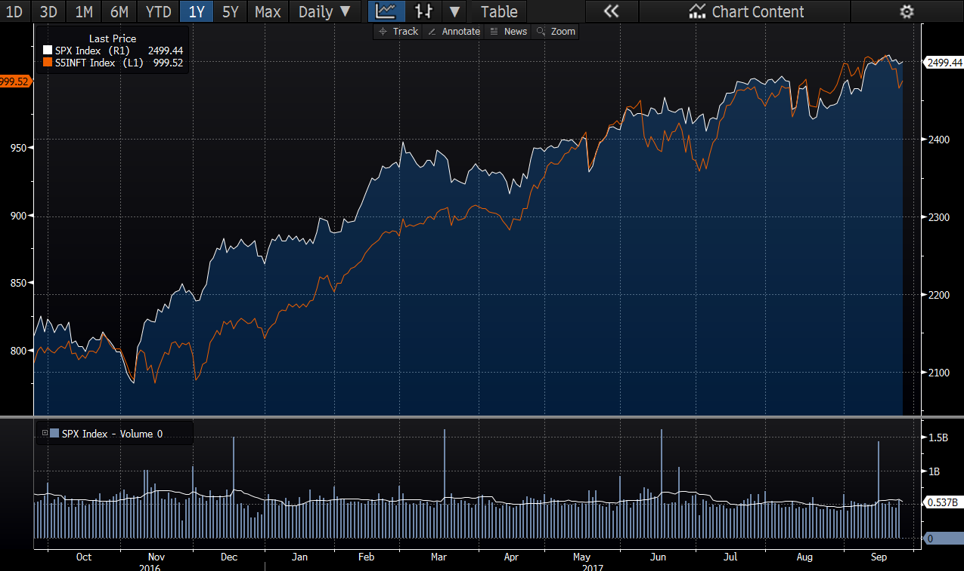
Information Technology
High level of substitute and elastic products
Driven mostly by design innovation, R&D costs extremely high
Areas of Growth: Cloud computing, Big Data, Internet of Things, and artificial intelligence
Outlook: Strong

Slide 26
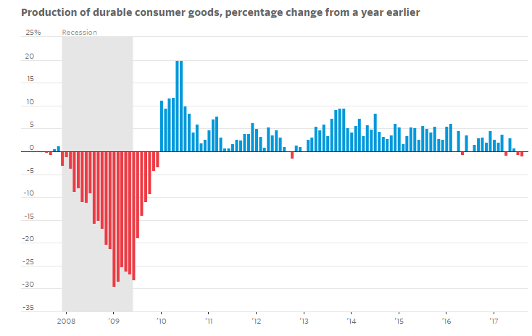
Consumer Goods

Slide 27
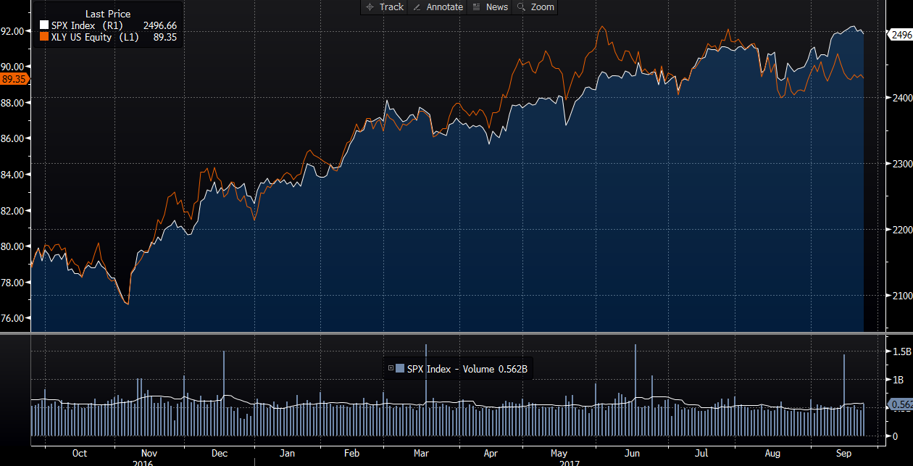
Consumer Discretionary
Outlook: Neutral
Sector highly correlated to the market:
=> Main drivers of the sector:
Employment
Interest rate
Correlated to the business cycle

Slide 28
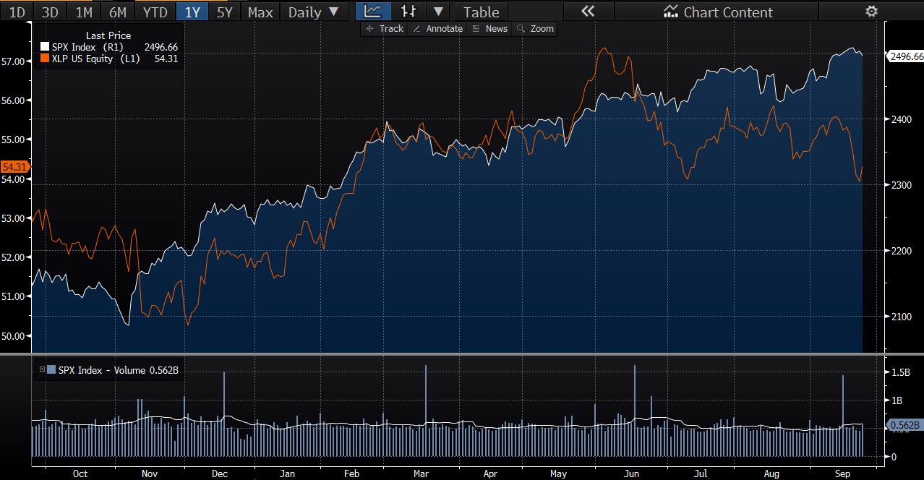
Consumer Staples
Outlook: Neutral
Low volatility in Consumer staples
Relatively stable demand
Non- cyclical
Products are inelastic
Main drivers of returns include the ability to reduce costs while revenues are relatively stable
Forecast: Demand for these products will remain consistent but the cost cutting initiatives of these companies will continue to drive profitability and earnings up as long as CPI for food and other non-cyclical items remains consistent.

Slide 29
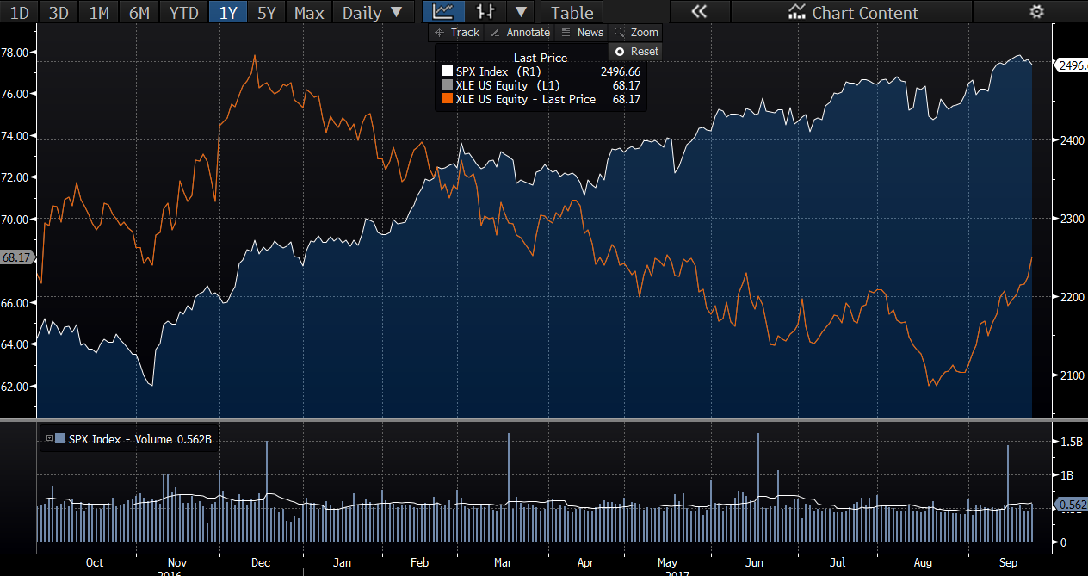
Energy Sector
Outlook - Neutral
Reasons for outlook - Modest global economic growth could raise demand for oil, rising geopolitical tensions could lead to higher oil prices
Areas of concern - Increased global supply, increased technological advancements, energy use restrictions

Slide 30
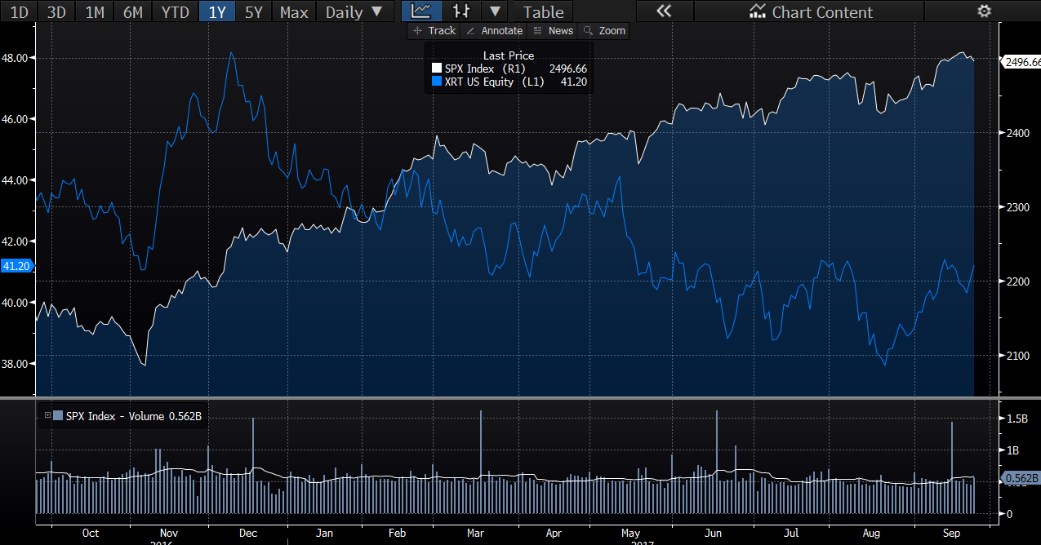
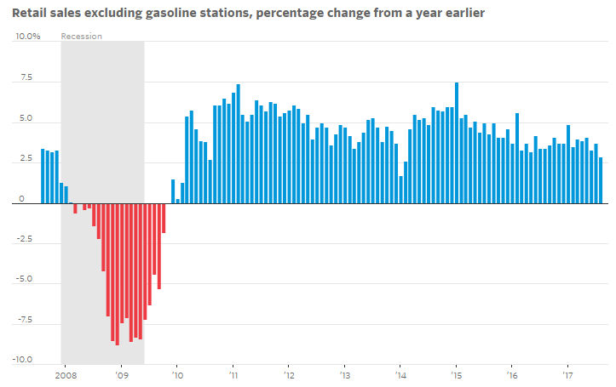
Retail
Cause for concern - This sector has struggled recently due to margins issues and costs of maintaining brick and mortars. Online companies such as Amazon do not look to be fading so value creation can only be created through a differentiated business model or best in class.
Notes:
Speak on amazon’s whole food venture and predatory pricing

Slide 31
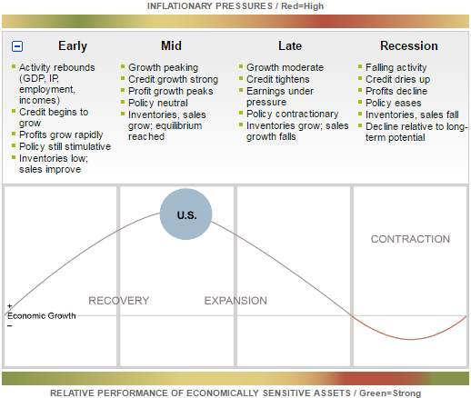
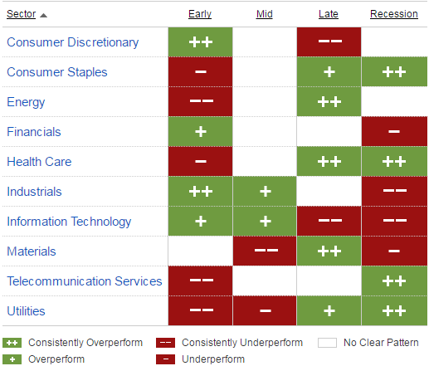
Sectors

Slide 32
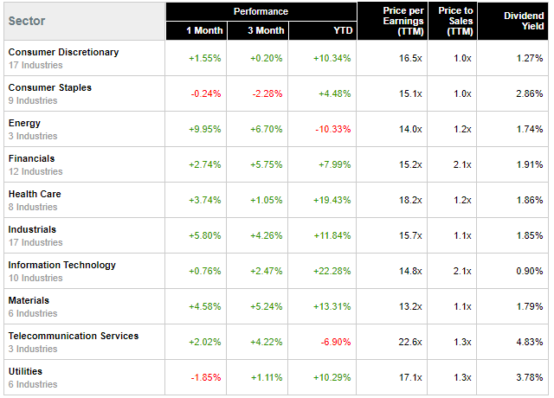
Sector Performance Summary

